Slide 1




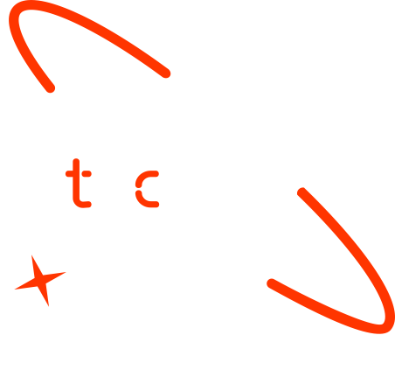

AI-Powered Malaria Diagnosis System with Mobile, Web, and Chatbot Integration
Malaria Screener
FTL Ethiopia ML Bootcamp
15th June 2025

Slide 2
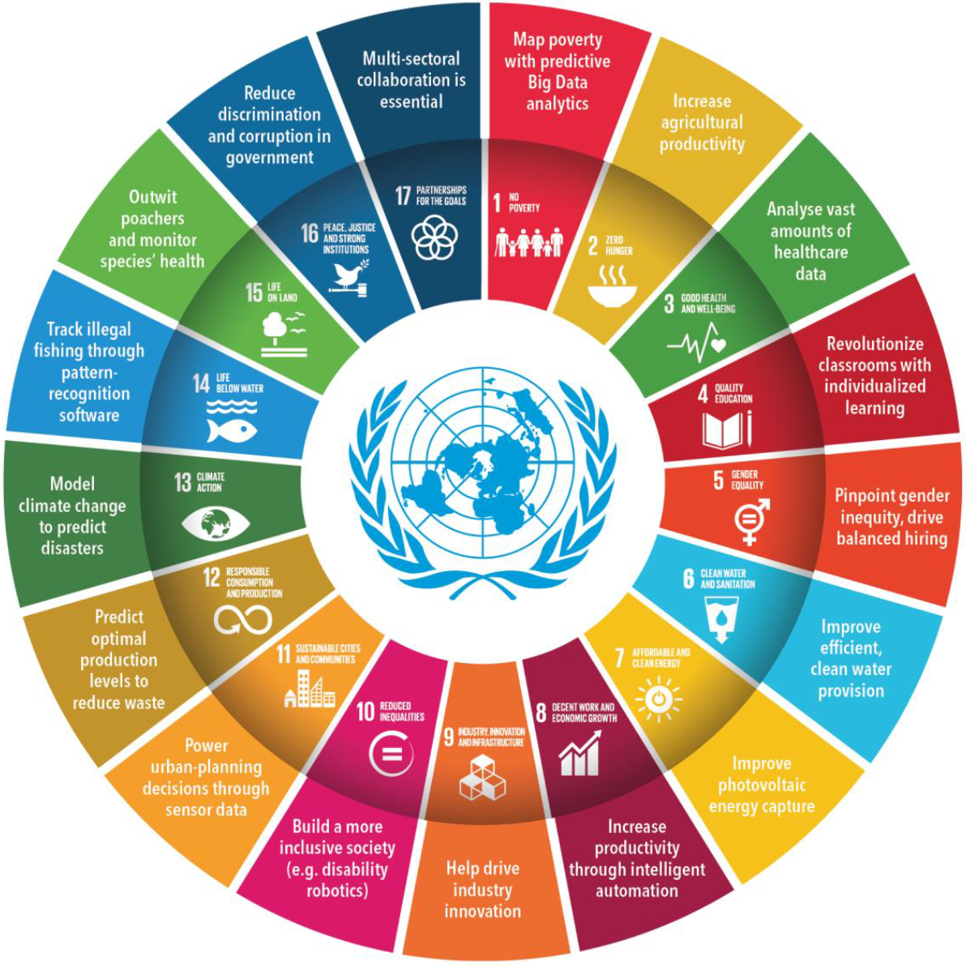
Outline
Concept note and implementation plan
Background
Objectives
SDG Relation
Data
Data Collection
Exploratory Data Analysis et Feature Engineering
Model
Model Selection and Training
Model Evaluation and Hyperparameter Tuning
Model Refinement and Testing
Results
Evaluation Results
Deployment
Future Work

Slide 3
Concept note and Implementation Plan
Notes:
FTs like precision agriculture, remote sensing & AI-powered forming equipment can help increase agricultural productivity in LDCs. This can improve fiid security & contribute to the achievement of SDG 2 (Zero Hunger).

Slide 4
Background
As of 2023, malaria remains a significant global health challenge, with approximately 263 million new cases and nearly 600,000 deaths reported.
The African continent bears the brunt of this burden, accounting for 94% of cases and 95% of malaria-related deaths.
Malaria is caused by five species of the Plasmodium parasite, with varying severity:
Plasmodium falciparum – The most dangerous and most common in Africa.
Notes:
FTs like precision agriculture, remote sensing & AI-powered forming equipment can help increase agricultural productivity in LDCs. This can improve fiid security & contribute to the achievement of SDG 2 (Zero Hunger).

Slide 5
Objectives
Develop a cross-platform mobile app (Flutter) for AI-powered malaria screening, a Next.js dashboard for healthcare providers, a Django backend, and a Malaria-specific chatbot for instant support.
The system:
Automate parasite detection in blood smears using AI-based models.
Store and manage patient records.
Provide a chatbot assistant for malaria-related queries.
Notes:
FTs like precision agriculture, remote sensing & AI-powered forming equipment can help increase agricultural productivity in LDCs. This can improve fiid security & contribute to the achievement of SDG 2 (Zero Hunger).

Slide 6
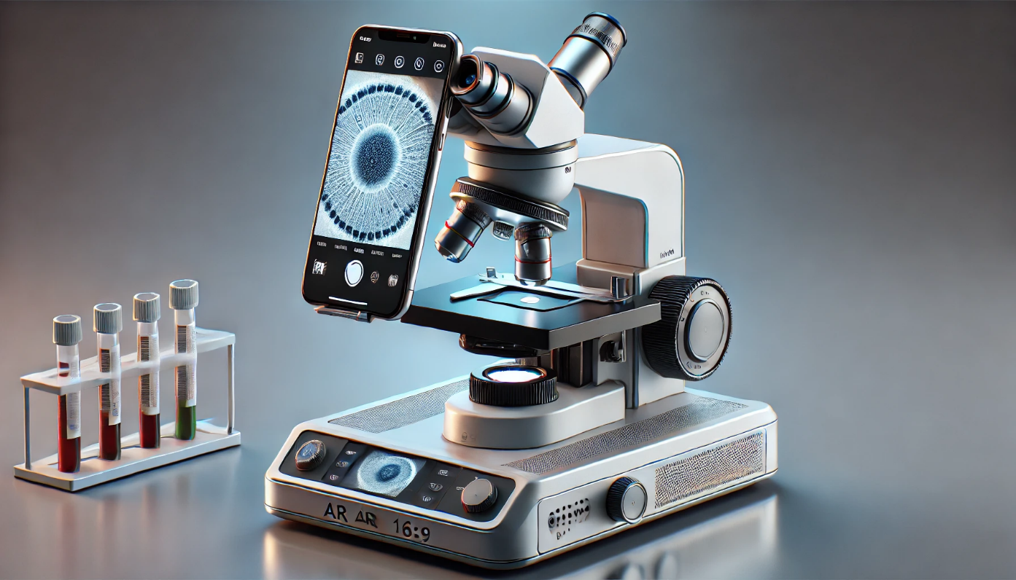
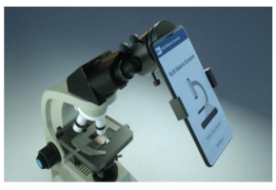
Proposed Solution
Source: AI Generated Images
Notes:
FTs like precision agriculture, remote sensing & AI-powered forming equipment can help increase agricultural productivity in LDCs. This can improve fiid security & contribute to the achievement of SDG 2 (Zero Hunger).

Slide 7

SDG Relation
Malaria is directly linked to the United Nations Sustainable Development Goals (SDGs),
particularly:
• SDG 3: Good Health and Well-being – Target 3.3 aims to end malaria by 2030.
“By 2030, end the epidemics of AIDS, tuberculosis, malaria and neglected tropical diseases and combat hepatitis, water-borne diseases and other communicable diseases “
Notes:
FTs like precision agriculture, remote sensing & AI-powered forming equipment can help increase agricultural productivity in LDCs. This can improve fiid security & contribute to the achievement of SDG 2 (Zero Hunger).

Slide 8
Data
Notes:
FTs like precision agriculture, remote sensing & AI-powered forming equipment can help increase agricultural productivity in LDCs. This can improve fiid security & contribute to the achievement of SDG 2 (Zero Hunger).

Slide 9
Data Collection
The project utilizes two primary sources of malaria blood smear images to ensure both diversity and clinical relevance:
NIH Malaria Dataset
Samples: 27,408
Type: Thin and thick blood smear images
Origin: Publicly available dataset curated by the National Institutes of Health (NIH)
Notes:
FTs like precision agriculture, remote sensing & AI-powered forming equipment can help increase agricultural productivity in LDCs. This can improve fiid security & contribute to the achievement of SDG 2 (Zero Hunger).

Slide 10
Exploratory Data Analysis and Feature Engineering
Dataset Overview:
Source: Cell images from microscopy (Parasitized vs. Uninfected).
Size: 27,558 images (13,779 Parasitized, 13,779 Uninfected).
Split: 80% training (22,048), 20% validation (5,510), full test set (27,558).
Exploratory Data Analysis:
Balanced classes ensure unbiased model training.
Image resolution: Variable, resized to 128x128 pixels for consistency.
Visual inspection: Parasitized cells show distinct ring-like structures; Uninfected cells are clearer.
Feature Engineering:
Resizing: All images standardized to 128x128 pixels.
Normalization: Pixel values scaled to [0, 1] (divided by 255).
Data Augmentation:
Rotation (20°), zoom (20%), horizontal flips.
Enhances model robustness to variations in cell orientation and scale.
Notes:
FTs like precision agriculture, remote sensing & AI-powered forming equipment can help increase agricultural productivity in LDCs. This can improve fiid security & contribute to the achievement of SDG 2 (Zero Hunger).

Slide 11
Model
Notes:
FTs like precision agriculture, remote sensing & AI-powered forming equipment can help increase agricultural productivity in LDCs. This can improve fiid security & contribute to the achievement of SDG 2 (Zero Hunger).

Slide 12
Model Selection and Training
Custom CNN: Built from scratch for baseline performance (~3.3M parameters).
MobileNetV2: Pre-trained on ImageNet, optimized for efficiency (~2.42M parameters).
MobileNetV2 leverages transfer learning, suitable for mobile deployment.
Notes:
FTs like precision agriculture, remote sensing & AI-powered forming equipment can help increase agricultural productivity in LDCs. This can improve fiid security & contribute to the achievement of SDG 2 (Zero Hunger).

Slide 13
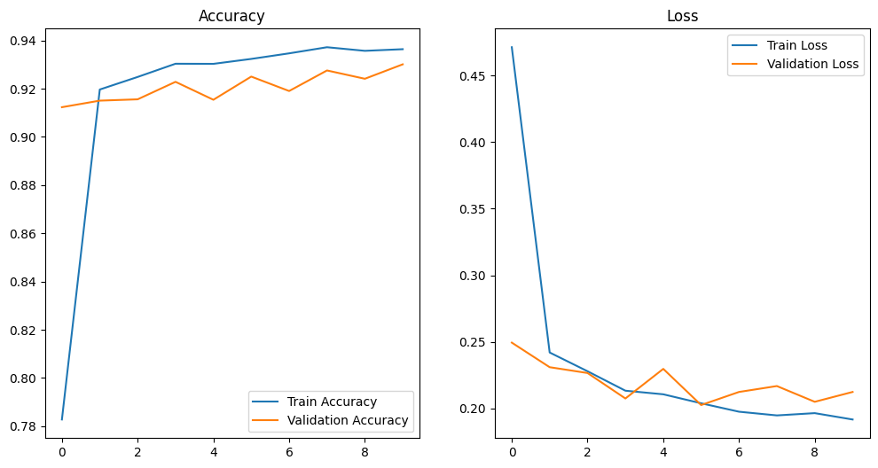
Model Selection and Training
Custom CNN:
loss: 0.2044
accuracy: 0.9283
Validation Accuracy: 0.93
Notes:
FTs like precision agriculture, remote sensing & AI-powered forming equipment can help increase agricultural productivity in LDCs. This can improve fiid security & contribute to the achievement of SDG 2 (Zero Hunger).

Slide 14
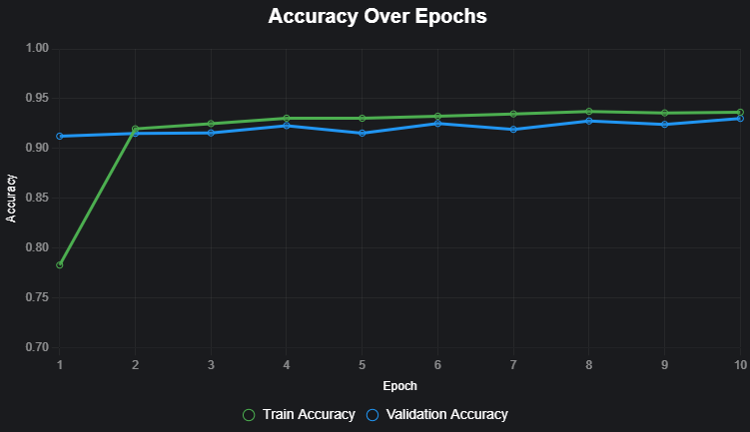
Model Selection and Training
MobileNetV2 :
loss: 0.2044
accuracy: 0.94973
Validation Accuracy: 0.95
Notes:
FTs like precision agriculture, remote sensing & AI-powered forming equipment can help increase agricultural productivity in LDCs. This can improve fiid security & contribute to the achievement of SDG 2 (Zero Hunger).

Slide 15
Model Evaluation and Hyperparameter Tuning
Hyperparameter Tuning:
Custom CNN: Fixed settings (learning rate, batch size=32, Adam optimizer).
MobileNetV2:
Learning rate: 1e-5 for fine-tuning (vs. default for initial training).
Epochs: 5 (initial) + 10 (fine-tuning).
Batch size: 32; dropout: 0.5 in head layers.
Tuning Strategy: Manual adjustment of learning rate for stability.
Notes:
FTs like precision agriculture, remote sensing & AI-powered forming equipment can help increase agricultural productivity in LDCs. This can improve fiid security & contribute to the achievement of SDG 2 (Zero Hunger).

Slide 16
Model Refinement and Testing
MobileNetV2:
Added custom head: Global average pooling, dense (128 units, ReLU), dropout (0.5), sigmoid output.
Fine-tuning: Unfroze base layers, trained 10 epochs with low learning rate (1e-5).
Improved validation accuracy from 92.49% (initial) to 94.97% (fine-tuned).
Notes:
FTs like precision agriculture, remote sensing & AI-powered forming equipment can help increase agricultural productivity in LDCs. This can improve fiid security & contribute to the achievement of SDG 2 (Zero Hunger).

Slide 17
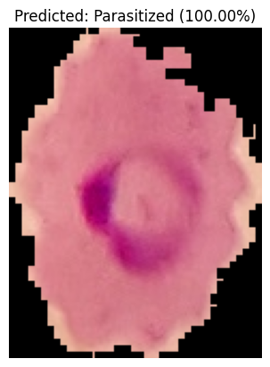
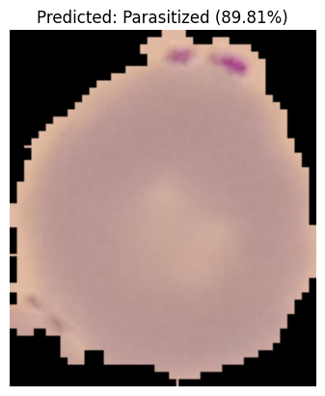
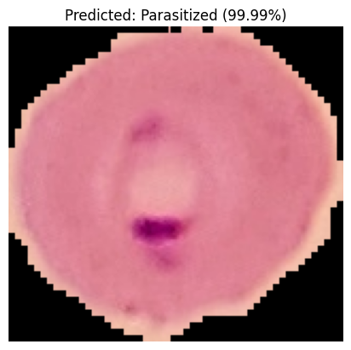
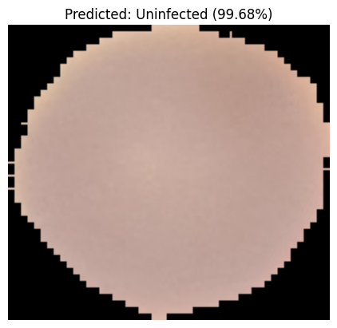
Model Refinement and Testing
Notes:
FTs like precision agriculture, remote sensing & AI-powered forming equipment can help increase agricultural productivity in LDCs. This can improve fiid security & contribute to the achievement of SDG 2 (Zero Hunger).

Slide 18
Results
Notes:
FTs like precision agriculture, remote sensing & AI-powered forming equipment can help increase agricultural productivity in LDCs. This can improve fiid security & contribute to the achievement of SDG 2 (Zero Hunger).

Slide 19
Evaluation Results
Metric | Custom CNN | MobileNetV2
Validation Accuracy | 92.83% (5,510 images, 10 epochs) | 94.97% (5,510 images, 15 epochs)
Test Accuracy | - | 96% (27,558 images)
Precision | - | Parasitized: 0.99, Uninfected: 0.94
Recall | - | Parasitized: 0.94, Uninfected: 0.99
F1-Score | Not available | Parasitized: 0.96, Uninfected: 0.96
Evaluation Scope | Qualitative predictions (~171ms/image) | Full test set metrics, confusion matrix
Key Strength | Solid baseline performance | High accuracy, reliable for diagnosis
Limitation | No test set evaluation | Slight misclassifications (~4%)
Notes:
FTs like precision agriculture, remote sensing & AI-powered forming equipment can help increase agricultural productivity in LDCs. This can improve fiid security & contribute to the achievement of SDG 2 (Zero Hunger).

Slide 20
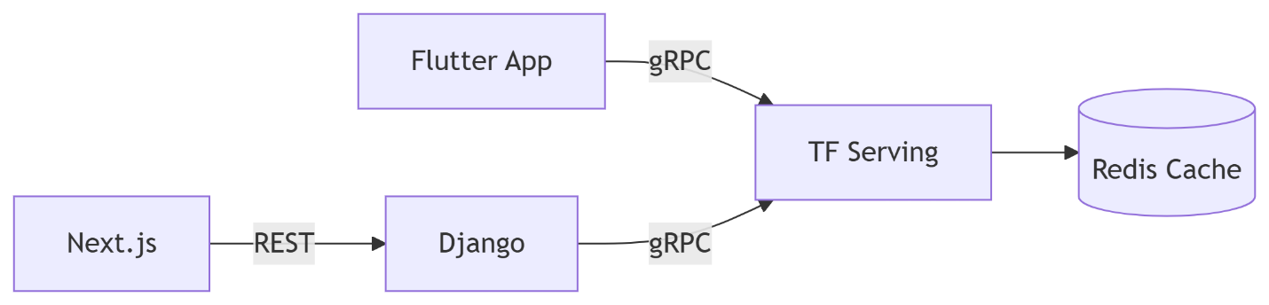
Deployment
Deployment Architecture Overview
Data Flow:
Flutter App → gRPC → TensorFlow Serving (for predictions).
Next.js → REST → Django (for data retrieval).
Django → gRPC → TensorFlow Serving.
Responses are cached in Redis for improved efficiency.
Key Benefits:
Real-time Data Processing: Efficient communication through gRPC.
Performance Optimization: Caching with Redis reduces response times.
Scalability: Separation of mobile and web applications enhances manageability..
Notes:
FTs like precision agriculture, remote sensing & AI-powered forming equipment can help increase agricultural productivity in LDCs. This can improve fiid security & contribute to the achievement of SDG 2 (Zero Hunger).

Slide 21
Future Work
We introduce a rapid, affordable smartphone application designed for malaria screening.
This app provides essential features with a user-friendly interface, enabling automatic screening of slides.
Management of images and metadata generated during the screening process, which can be utilized to further enhance the image analysis model.
Future Enhancements: detect multiple species, enable offline functionality, gather user feedback.
Counting of infected red blood cells and parasites for P. falciparum malaria.
Predicting Malaria Outbreaks
Notes:
FTs like precision agriculture, remote sensing & AI-powered forming equipment can help increase agricultural productivity in LDCs. This can improve fiid security & contribute to the achievement of SDG 2 (Zero Hunger).

Slide 22
References
1. Chittagong Medical College Hospital. (2020). De-identified patient records. IRB#129
2. Google Health. (2022). AI for Malaria Diagnosis. https://ai.google/social-good/health/
3. NIH Malaria Dataset. National Institutes of Health.https://lhncbc.nlm.nih.gov/publication/pub9932
4. Palanica et al. (2019). AI Chatbots in Healthcare: A Systematic Review. JMIR.
5. Rosado et al. (2017). Mobile-Based Analysis of Malaria-Infected Blood Smears. Sensors.
6. TensorFlow Team. (2023). On-Device ML with TF Lite. https://www.tensorflow.org/lite
7. WHO. (2021). Digital Health Interventions. https://www.who.int/health-topics/digital-health
8. WHO. (2021). Malaria Treatment Guidelines, 3rd Edition.
9. Yang et al. (2019). Deep Learning for Smartphone-Based Malaria Parasite Detection. IEEE JBHI.
10. Yu et al. (2020). Malaria Screener: A Smartphone Application for Automated Malaria Screening. BMC Infectious Diseases.
Notes:
FTs like precision agriculture, remote sensing & AI-powered forming equipment can help increase agricultural productivity in LDCs. This can improve fiid security & contribute to the achievement of SDG 2 (Zero Hunger).

Slide 23


Thank you!

